Slide 1
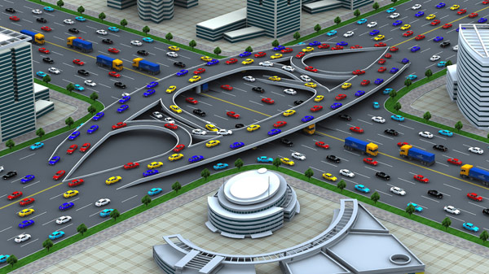
Traffic Engineering
University of Diyala
College of Engineering
Civil Engineering Department

Slide 2
TRAFFIC Flow
ELEMENTS

Slide 3
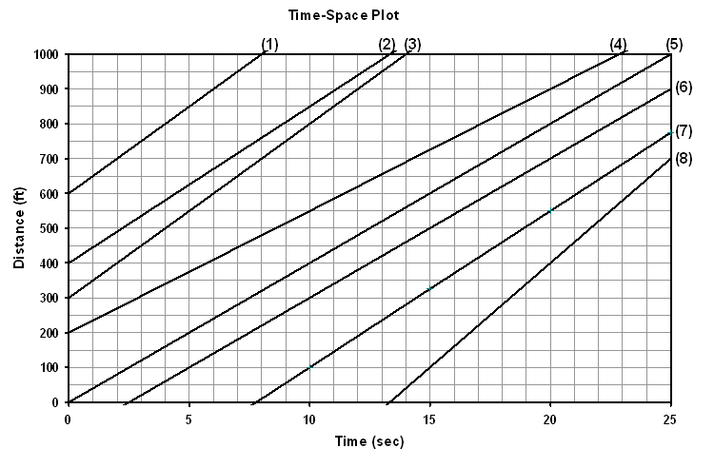
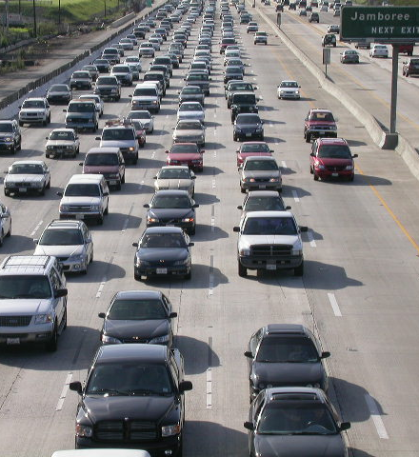
Flow Rate(q):
The equivalent hourly rate at which vehicles pass a point on a highway lane during a time period less than one hour.
q = n \T

Slide 4
Density (K)
Number of vehicles traveling over a unit length of highway at an instant in time, expressed as vehicles per time per distance in a lane (veh/hr/km)
k = n \ L

Slide 5
Density (K)

Slide 6
Speed (u)
The distance traveled by a vehicle during a unit of time, expressed as distance per time.
u = L \ ti

Slide 7
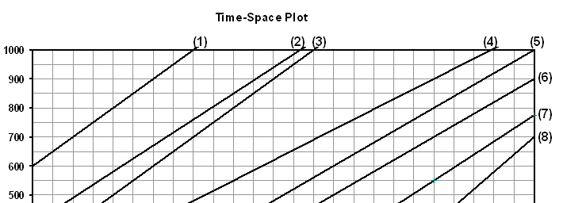
Time Mean Speed (ū_{t})
The arithmetic mean of the speeds of vehicles passing a point on a highway during an interval of time.
ūt = Ʃui / n
Mile post
Observation Period

Slide 8
Space Mean Speed (ū_{s})
The harmonic mean of the speeds of vehicles passing a point on a highway during an interval of time.
ū_{s} = nL/ Ʃti
Observation Distance
Observation Period

Slide 10

Time Headway (h)
The difference between the time the front of a vehicle arrives at a point on the highway and the time the front of the next vehicle arrives at that same point, expressed in second (s).
T=0 sec
T=3 sec
h₁₋₂=3sec

Slide 11

Space Headway (d)
The distance between the front of a vehicle and the front of the following vehicle, expressed in meter (m , ft , in).
d₂₋₃
d₁₋₂

Slide 12

Gap(g)
The difference between the time the back of a vehicle arrives at a point on the highway and the time the front of the next vehicle arrives at that same point, expressed in second (s).
g = h – (l\ ūs)

Slide 13
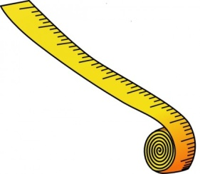
Clearance(c)
The distance between the back of a vehicle and the front of the following vehicle.
c = g x ūs

Slide 14
The time-space diagram:
It is a graph that describes the relationship between the location of vehicles in traffic stream and time as the vehicles progress along the highway.
1
2
3
4
5
h₃₋₄
d₁
6
Distance
d₂
d₃₋₄
d₃
d₄
t₃
t₃"
t₅
t₆
Time

Slide 15
Example-1
What are the individual headways and the average headway measured at location A during the 25 sec period?
A

Slide 16
Example-1
A
h₁₋₂
h₂₋₃

Slide 17
Example-2
Vehicles traveling at constant speeds on a 2-lane highway between sections X & Y with their positions and speeds obtained at an instant of time by photography. An observer located at point X with observer the four vehicles passing point X during a period of time, T sec, with velocities 110, 100, 90, and 75 km/hr, respectively.
15m
5m
45m
5m
50m
5m
100m
5m
70m
75 km\hr
90 km\hr
100 km\hr
110 km\hr
X
Y
300 m

Slide 18
Example-3
A section of highway having a length 60 m. The observed data are 6 vehicles cross over it in a period of 148 sec., for the following duration: 2.4, 2.8, 3.0, 2.1, 2.2, and 3.5 sec. Estimate the values of the flow rate, density, space-mean speed, time-mean speed, average gap, and average clearance. If the length of vehicles are 6, 5.4, 6.6, 4.8, 7.5, and 6 m respectively?

Slide 19
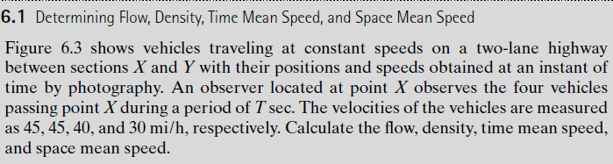

Slide 22
H.W-1
A vehicles Platoon was observed over a distance of 1000 ft on a single lane on a street, entering at point (A) and departing at point (B)
Plot the trajectories of these six vehicles on graph paper
Calculate the flow rate , density , speed , time mean speed , space mean speed , time headway , space headway , gap and clearance
Assuming the first 10 second at (A) as the period of observation, and the length of vehicle is 20 ft.
Vehicle | Time at (A) sec. | Time at (B) sec.
1 | 0 | 35
2 | 2 | 37
3 | 3 | 39
4 | 5 | 42
5 | 6 | 44
6 | 8 | 48

Slide 23
Fundamental Relationships
The relation between
Flow and Density,
Density and Speed,
Speed and Flow,
They are referred to as the fundamental diagrams of traffic flow.

Slide 24
Flow - Density
The flow and density varies with time and location.
Some characteristics of an ideal flow-density relationship are listed below:
1- When the density is zero, flow will also be zero, since there are no vehicles on the road.
2- When the number of vehicles gradually increases the density as well as flow increases.

Slide 25
Flow - Density
3- When more and more vehicles are added, it reaches a situation where vehicles can't move. This is referred to as the jam density or the maximum density. At jam density, flow will be zero because the vehicles are not moving.
4- There will be some density between zero density and jam density, when the flow is maximum.

Slide 26
Speed - Density
Speed will be maximum, referred to as the free flow speed.
When the density is maximum, the speed will be zero.

Slide 27
Speed - Density
Corresponding to the zero density, vehicles will be flowing with their desire speed, or free flow speed.
When the density is jam density, the speed of the vehicles becomes zero.

Slide 28
Speed - Flow
The flow is zero either because there are no vehicles or there are too many vehicles so that they cannot move.
At maximum flow, the speed will be in between zero and free flow speed.
The maximum flow qmax occurs at speed u.

Slide 29
Speed - Flow
It is possible to have two different speeds for a given flow.
The high speed u2 refer to low density but the lower speed u1 refer to high density with flow is constant.

Slide 30
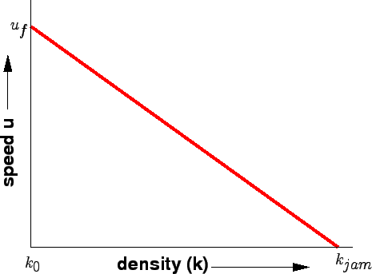

Traffic Stream Models
Speed - Density
K = 0 <…….> U_{s} = U_{f}
K = K_{j} <……> U_{s} = 0
U_{f} : Free flow speed
K_{j} : Jam density
U_{s} : Space mean speed
K : Density

Slide 31
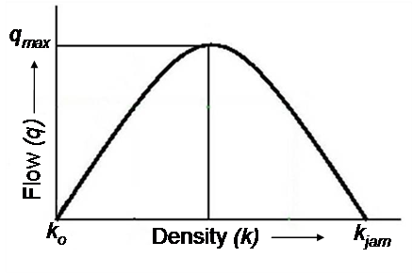


Traffic Stream Models
Flow - Density
Q = Us * K
K = 0 <…….> Q = 0
K = K_{j} <……> Q = 0
K = K_{m} <……> Q = Q_{m}
Q_{max} = U_{m} * K_{m}
Q_{m}: Optimal flow = maximum flow = capacity
K_{m} : Optimal density = critical density
U_{m} : Optimal speed = critical speed

Slide 32
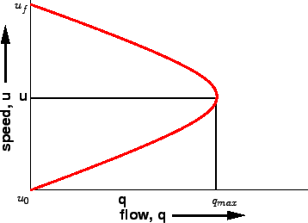


Traffic Stream Models
Speed - Flow
Q = Us * K
Q_{max} = U_{m} * K_{m}
K = 0 <…….> U_{s} = U_{f} <…….> Q = 0
K = K_{j} <……> U_{s} = 0 <…….> Q = 0
K = K_{m} <……> U_{s} = U_{m} <…….> Q = Q_{m}

Slide 33
Example-3
Considering linear relationship between density and speed, if the number of vehicle observed on a segment of road with length 1.2 km is 96 veh. Knowing that the jam density is 100 veh./km, calculate the following:
The Spacing ?
The free flow speed when the flow rate is 1600 veh/hr ?
Space mean speed ?

Slide 34
Example-4
Considering linear relationship between density and speed, you are required to estimate the corresponding flow and speed values to densities of (10 , 20 , 30 , 40 , 50 , 60 , and 70) veh/km if the free flow speed is 90 km/hr and at critical situation, it is founded that there are 110 vehs on a section of road with length 2.0 km. using the estimated values, draw a sketch showing the speed-flow-density relationships ?

Slide 35
Example-5
The relation between the traffic flow characteristics for a highway follows the relation
Us = 100 – 0.8 k
Derivate the main relations between the traffic flow characteristics for this highway using sketches to show your answer? Determine the speed and density at Q = 2000 veh/hr?

Slide 36
H.W-1
A traffic stream displays average vehicle time headway of 2 sec at space mean speed 60 km/hr. compute average space headway, flow rate and density for traffic stream?
H.W-2
A sample of data collected for a portion of highway indicated that the maximum free flow was 2000 veh/hr and the jam density was 100 veh/km. determine the free flow speed on the portion of the highway. Then construct a linear relationship between the space mean speed and the density for this portion of highway?

Slide 37


